Slide 1
FASTA
ACTGTGCCGTTAAACGTGATTAAATCCGTACTGATAT…
GenBank
TetR
GFP
pTet
SBOL 1.1
TetR
GFP
pTet
aTc
TetR
TetR
GFP
SBOL 2.0
TetR
GFP
pTet

Slide 2


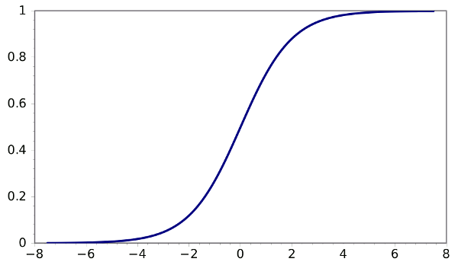




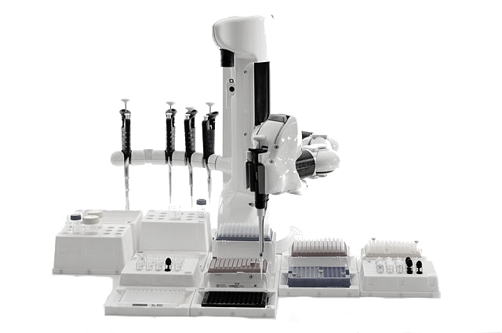
RESOURCES
CAD/Modeling
sbolstandard.org
SBOL documents (RDF/XML format)
open source software libraries (libSBOL)
images, fonts, and webtools
converters
ontologies
Measurement
Sequencing
&
Synthesis
Publication
Repositories & Databases
Automation

